Slide 1
Newton’s Method for One-Dimensional Optimization
by
Dr. Md. Rajibul Islam
CSE, UAP

Slide 2
Newton’s Method-Overview
Open search method
A good initial estimate of the solution is required
The objective function must be twice differentiable
Unlike Golden Section Search method
  Lower and upper search boundaries are not required (open vs. bracketing)
  May not converge to the optimal solution

Slide 3


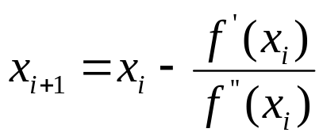
Newton’s Method-How it works
The derivative of the function , at the function’s maximum and minimum.
The minima and the maxima can be found by applying the Newton-Raphson method to the derivative, essentially obtaining

Slide 4






Newton’s Method-Algorithm
Initialization: Determine a reasonably good estimate for the maxima or the minima of the function .
Step 1. Determine and .
Step 2. Substitute (initial estimate for the first iteration) and into
to determine and the function value in iteration i.
Step 3.If the value of the first derivative of the function is zero then you have reached the optimum (maxima or minima). Otherwise, repeat Step 2 with the new value of

Slide 5

Example
.
2
2
θ
2
θ
The cross-sectional area A of a gutter with equal base and edge length of 2 is given by
Find the angle θ which maximizes the cross-sectional area of the gutter.

Slide 6




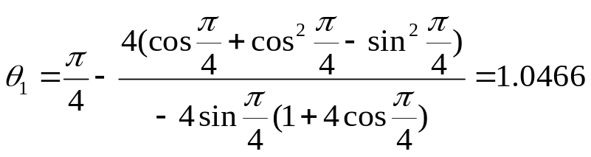

Solution
The function to be maximized is
Iteration 1: Use as the initial estimate of the solution

Slide 7
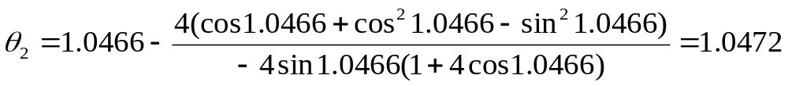




Solution Cont.
Iteration 2:
Summary of iterations
Iteration | θ
1 | 0.7854 | 2.8284 | -10.8284 | 1.0466 | 5.1962
2 | 1.0466 | 0.0062 | -10.3959 | 1.0472 | 5.1962
3 | 1.0472 | 1.06E-06 | -10.3923 | 1.0472 | 5.1962
4 | 1.0472 | 3.06E-14 | -10.3923 | 1.0472 | 5.1962
5 | 1.0472 | 1.3322E-15 | -10.3923 | 1.0472 | 5.1962
Remember that the actual solution to the problem is at 60 degrees or 1.0472 radians.

Slide 8
THE END

